Slide 1
Influencing Through Design – Using Intervention Logics To Influence
Paul Vance
Wellington, New Zealand
Notes:
Will invite questions later in the paper and there will be an opportunity for discussion as well.
Content of this presentation represents my personal views and experiences, not those of Inland Revenue.
The subject of this paper has come about from:
authors experience as an internal evaluator in large, public sector organisations.
project staff often have clear ideas of what they wish to achieve in programmes although they are not commonly articulated as outcomes
project staff involved in developing a programme often have a clear view of the activities
rarely, in the author’s experience, is there a clear view in the mind of project staff of how these two areas might meet.
even less common are clear linkages between the outcomes sought and the activities undertaken.
as a result of this, and in collaboration with a number of colleagues, the author began to work with project staff to develop intervention logic models for programmes requested for evaluation.
one such early model for an overarching return-to-work programme is discussed later in this paper. It became clear during the early stages of this that it was possible to subtly and positively influence programme design and make the projects more evaluable and to build some evaluative thinking within the project teams.

Slide 2
Structure
Background
Why is this important
Some examples
Some questions for you…
Concluding comments
Notes:
Areas I would like to cover today are:
Some background to place this presentation in context
Why I believe that this area is important
Some examples of my experience.
Some examples of best practice
Questions for you, the audience, to consider and an opportunity for some discussion.
Some concluding comments
Please feel free to ask questions or add comments throughout the presentation.

Slide 3
Some background
Intervention logics in the New Zealand public sector
My introduction to intervention logics
The theory base.
Notes:
IVL in the NZ public sector have a reasonably long history
In the New Zealand context, a significant push to use ILM came in the 1990’s and 2000’s with many documents from the State Service Commission advocating the use of the method as part of the Pathfinder Project
use of intervention logics also included as part of the push for Managing for Outcomes (MfO) which was said to “lead to a more responsive Public Service that is better able to identify and deliver the interventions that best contribute to the outcomes Government is seeking. This may mean doing things differently, having the confidence to better align resources to the most effective and efficient outputs.”
First experienced IVL at the Tertiary Education Commission with the Performance Based Research Fund evaluation.
IVL little used as too complex and unintelligible (1 page diagram; 80 pages of explanation)
Sparked interest in how to utilise IVL’s in evaluation and potential influence of them.
???
The theory base-
The concepts within this paper have emerged from many areas of theory within the evaluation literature. It is hard to isolate specific areas, but of particular note is-
Work by Michael Quinn Patton advocating utilisation focussed evaluation.

Slide 4
Why is this important?
Maximise evaluation impact
More cost effective evaluation spend
Greater utility of evaluation findings
Increasing the influence of evaluation
Boosting evaluation capability and evaluative thinking
Notes:
Maximise evaluation impact. This is the ‘holy grail’ to evaluators and, from the author’s point of view, is where influencing project design is most important.
Most recognise the importance of maximising impact in positive, constructive, influencing manner.
This becomes even more important when services are under cost pressure
Often asked to existence of evaluation.
More cost effective evaluation spend. The public sector internationally is experiencing pressure on budgets – a situation particularly marked in the NZ public sector.
Even before the current economic climate spending has been tightly controlled.
More specifically, stakeholders are often concerned with evaluation demonstrating and articulating value for the investment made.
Influencing project design assists in this by helping to identify the areas where evaluation is needed and where it isn’t, directing evaluation resource to where it is most effectively used.
Greater utility of evaluation findings. By influencing project design it is clear that evaluation design can be moulded to be ‘fit for purpose’. If this is done, then it is likely that evaluation findings will have greater utility. Patton and UFE?
Increasing the influence of evaluation. It might seem obvious to state this – but increasing the influence of evaluation begins with influencing project design. The author’s experience as an ‘internal evaluator’ is that the ‘success’ of evaluation projects can rest on this influence.
Boosting evaluation capability. Project activity should always boost the evaluation capability of the stakeholders involved. This is a central tenet of the author’s evaluation practice.
Boosting evaluation capability assists in relationship management and development and through this assists in building the influence of evaluation.
Improving evaluative thinking. Defining what constitutes ‘evaluative thinking’ is difficult. But with the evaluation capability point made previously, anecdotal evidence suggests that improving evaluative thinking in stakeholders often improves the use and influence of evaluation findings.

Slide 5
Some examples …

Slide 6
Stay at work
Background and context
Developing the IVL
Impact of IVL
Notes:
Background and context
Project at ACC – state owned accidental injury insurer
Set against growing cash expenditure on income compensation and increasing future liability
Extensive evidence that if employee stays at work, healing is more efficient and effective
Government requirement to reduce levies by reducing costs
Represents about four different discrete programmes
Developing the IVL
Developed in two workshops
First workshop asked series of questions about key activities and outcomes
Draft of IVL then formulated and circulated prior to second workshop
Second workshop to discuss draft and identify changes.
Stakeholders then signed off final IVL
Impact of IVL
Stakeholder realisation and consensus on common aspects of programmes
Identification of key differences
Changes to programme
Concluding comments

Slide 7
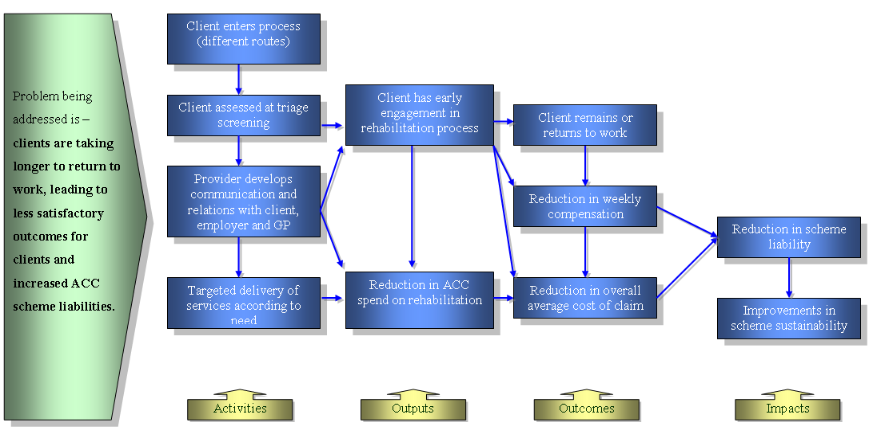
Notes:
Intentionally simple
Value less in diagram produced than work that went into it
Pitched at a high level as across four differing discrete programmes
Hardest bit being to agree the problem being addressed.
Stakeholders stymied by question “what does success look like in this project?”

Slide 8
Stay at work
Background and context
Developing the IVL
Impact of IVL
Changes to programme
Concluding comments
Notes:
Background and context
Project at ACC – state owned accidental injury insurer
Set against growing cash expenditure on income compensation and increasing future liability
Extensive evidence that if employee stays at work, healing is more efficient and effective
Government requirement to reduce levies by reducing costs
Represents about four different discrete programmes
Developing the IVL
Developed in two workshops
First workshop asked series of questions about key activities and outcomes
Draft of IVL then formulated and circulated prior to second workshop
Second workshop to discuss draft and identify changes.
Stakeholders then signed off final IVL
Impact of IVL
Stakeholder realisation and consensus on common aspects of programmes
Identification of key differences
Changes to programme
Concluding comments

Slide 9
Hidden economy
Background and context
Developing the IVL

Slide 11
Hidden economy
Background and context
Developing the IVL
Impact of IVL
Changes to programme
Concluding comments

Slide 12
Some questions for you.
Just what is best practice?
What is the best way to influence?
What is the best way to introduce IVL’s to an organisation?

Slide 13
Concluding comments
Nothing new here today…
Emphasise getting fundamentals right!
No answers, just some questions…
Questions…

